Slide 1
Intergenerational Mobility Curves
Jon Davis
Harris School of Public Policy, Univ. of Chicago
Bhash Mazumder
Federal Reserve Bank of Chicago
November 4, 2014

Slide 2
This talk also includes some very preliminary work on:
“A Comparison of Intergenerational Mobility Curves in Germany, Norway, Sweden and the U.S”
with:
Espen Bratberg, University of Bergen
Jon Davis, Harris School of Public Policy, University of Chicago
Martin Nybom, SOFI, Stockholm University
Daniel Schnitzlein, University of Hannover
Kjell Vaage, University of Bergen
hceconomics.org

Slide 3
Goals
Introduce the general approach of “mobility curves”:
Follow Aaberge and Mogstad (2012) who study intragenerational mobility by applying concepts from the inequality/social welfare literature (Atkinson 1970, Yaari 1988, Aaberge and Mogstad 2010). We further extend this to intergenerational mobility
Consider mobility across the entire income distribution, hence a “curve”
Allows for potential nonlinearities and differences in upward vs. downward moves
Useful for comparing subgroups or different populations
We consider both absolute and relative mobility as well as a hybrid
Compare mobility over time, across groups, and across countries
Will consider both individual and geographic covariates
Can analyze mobility with respect to other outcomes, (e.g. test scores)
Eventually, can try to make statements about social welfare
hceconomics.org

Slide 4
Background
Newer focus in literature on rank-based measures
Bhattacharya and Mazumder (2011), Mazumder (2014) and Corak, Lindquist and Mazumder (forthcoming) use directional rank mobility
Dahl and Deliere (2008) and Chetty et al (2014) use intergenerational rank association.
Conceptually these measures are about positional mobility and abstract from magnitude of income differences (inequality)
Has intergenerational mobility changed over time?
Long and Ferrie (2013): occ. mobility fell from 19th to mid-20th century
Mixed evidence for 20th century
PSID studies suggest no trend in recent decades (e.g. Hertz, 2008; Lee and Solon, 2009)
Other studies (e.g. Aaronson and Mazumder, 2008) suggest that mobility changes correspond to inflection points in inequality/returns to schooling (e.g. 1940 and 1980).
Chetty et al (2014b) show no trend in rank association but only for cohorts born since 1970 (observed at young ages) who entered labor market in 1990s and 2000s.
hceconomics.org

Slide 5
Background (cont.)
Large racial differences in intergenerational mobility in US
Hertz (2005) found blacks substantially less upwardly mobile and whites substantially more downwardly mobile using PSID.
Bhattacharya and Mazumder (2011) and Mazumder (2014) find similar results using multiple data sources and with rank measures. Results imply no convergence in the steady state distribution
But…no evidence yet on Hispanics
Large geographic differences found by Chetty et al (2014)
Use millions of tax records for 1980-82 cohorts observed in 2011-12.
Construct two measures for each commuting zone:
Expected rank for individuals coming from 25th percentile
Slope of intergenerational rank association line
However, limited individual covariates (e.g. race, parent education)
hceconomics.org

Slide 6
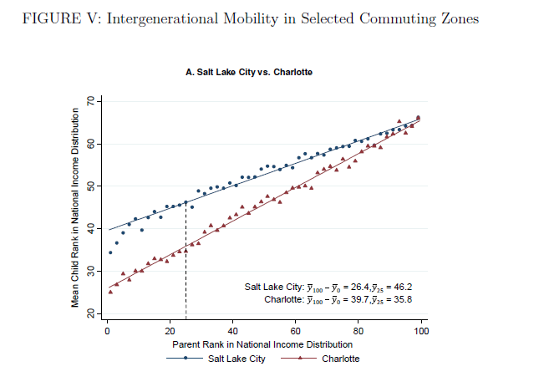
hceconomics.org

Slide 7
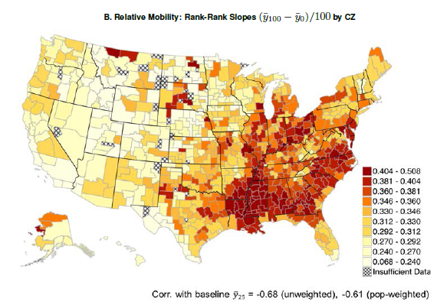
hceconomics.org

Slide 8
Three Mobility Curve Measures
Rank Mobility (rank changes):
- where 0,1 index generations and p is the percentile in the parent generation - we will show a) raw data b) smoothed kernel c) linear - RM contains same info as conditional expected rank (“rank association”)
Absolute Mobility (change in income)
Income Share Mobility (change in income share)
hceconomics.org
Notes:
Smoothed rank change at individual level
Hybrid of relative and absolute

Slide 9
Baseline US Data: NLSY79
Kids between ages of 14-22 in 1979 followed into adulthood
Parent Generation: use average total net family income over 1978, 1979 and 1980.
Includes all non-missing years of income (includes zero income)
Boys and girls living with parent, income reported directly by parent
31% have 3 years of income, 24% have 2 years, 21% have 1 year.
Use average of adult child’s total net family income in 1996, 1998, 2000, 2002, 2004, 2006 and 2008 (when non-missing).
36 percent have all 7 years of income, 65 percent have at least 4 years of income.
Adult children ages are between 33 and 52
Include oversamples and use weights
Our final sample includes 6767 observations on 1957-64 cohorts

Slide 10
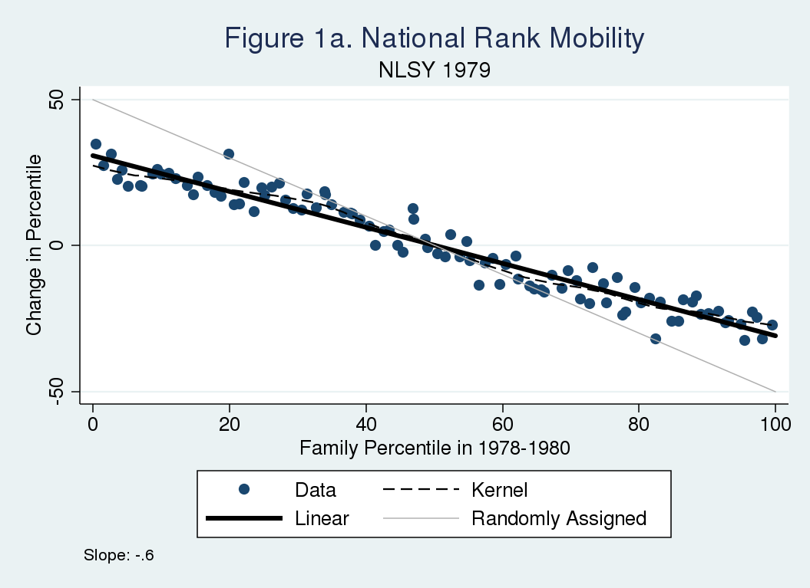
hceconomics.org

Slide 11
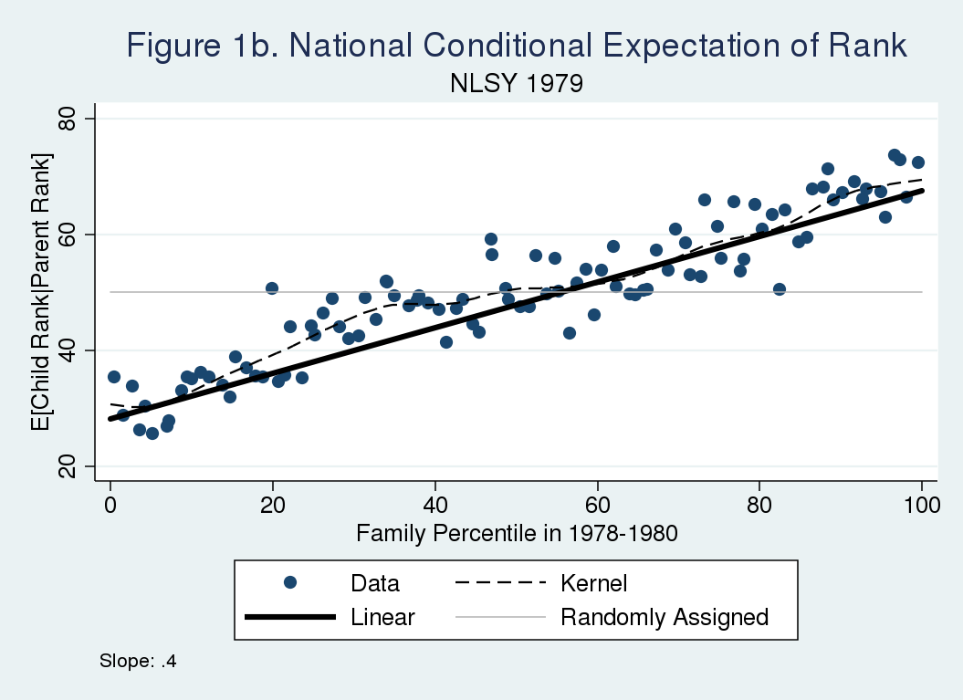
hceconomics.org

Slide 12
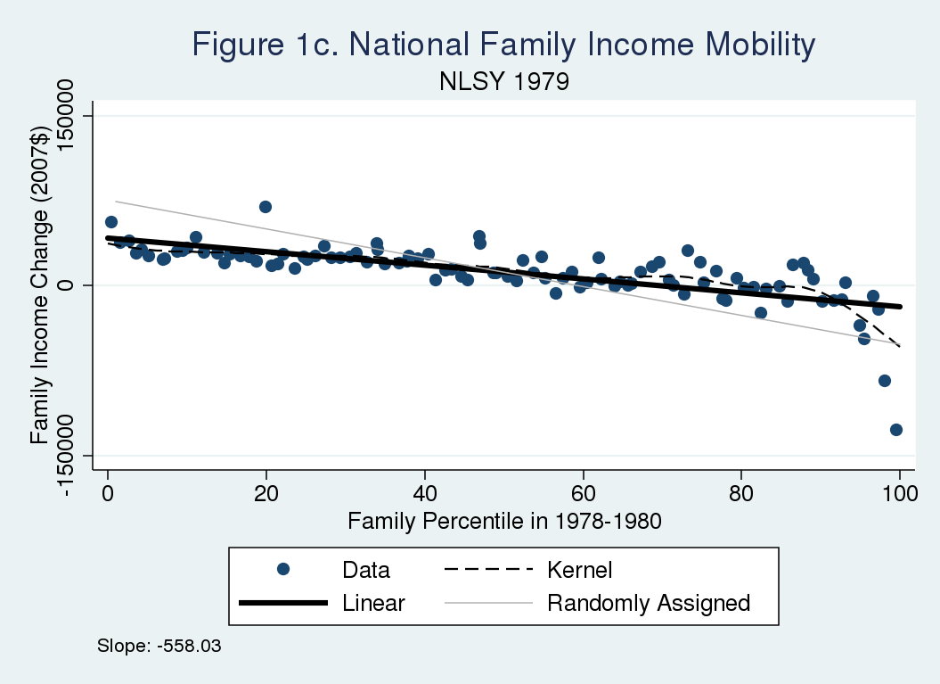
hceconomics.org

Slide 13
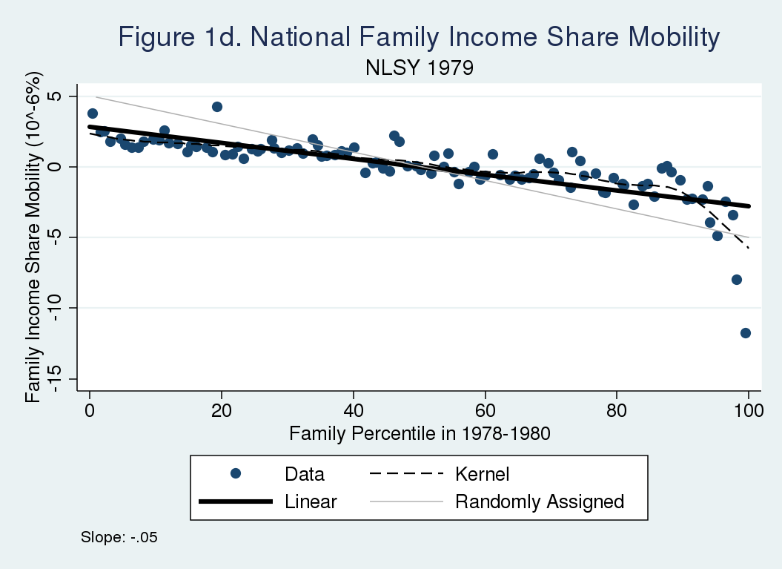
hceconomics.org

Slide 14
US Trends
hceconomics.org

Slide 15
Compare NLSY79 to NLS66
NLS66 covers children between ages of 14-24 in 1966
Young Women followed until 2001 (Young men only to 1981)
Linked to Mature Men/Women cohorts =>fathers and mothers
Parent generation:
Use average total net family income over 1965, 1966 and 1968.
Daughters: Use avg. of total net family income in 1991, 1993, 1995, 1997, 1999, and 2001 (when non-missing). Age is between 38 and 59
Include oversamples and use weights
Adjust NLSY sample to match parent age range of NLS66
Final sample: 978 daughters, 1942-52 cohorts
Caveat: Shows changes in positional mobility only and does not account for changes in inequality across these cohorts

Slide 16
Mobility Curve Comparisons
When comparing rank mobility curves across different populations (e.g. countries, over time):
Curves will almost certainly cross
Different social welfare functions may yield different normative conclusions
Depend on upward mobility at bottom vs downward mobility at the top
Absolute mobility curves may very well not cross
When comparing curves within a given population (e.g. subgroups such as race, region, ethnicity using a fixed distribution)
Curves may or may not cross
Stochastic dominance more likely and one group’s mobility curve might always be preferred over another
hceconomics.org
Notes:
Smoothed rank change at individual level
Hybrid of relative and absolute

Slide 17
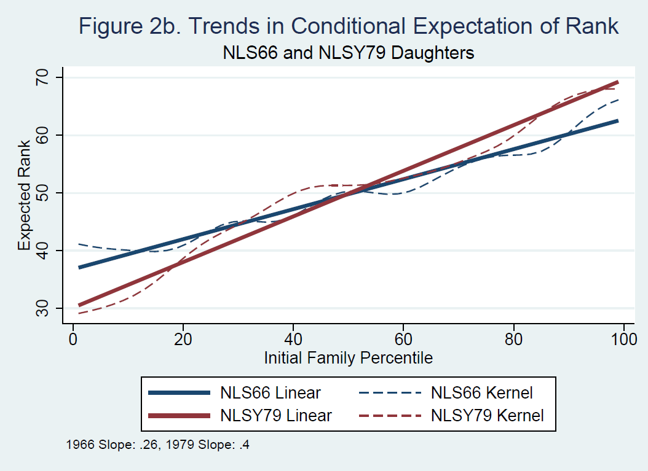
Moving from 0.26 to 0.40 equivalent to moving from 40th to 338th ranked city using Chetty et al online tables
hceconomics.org

Slide 18
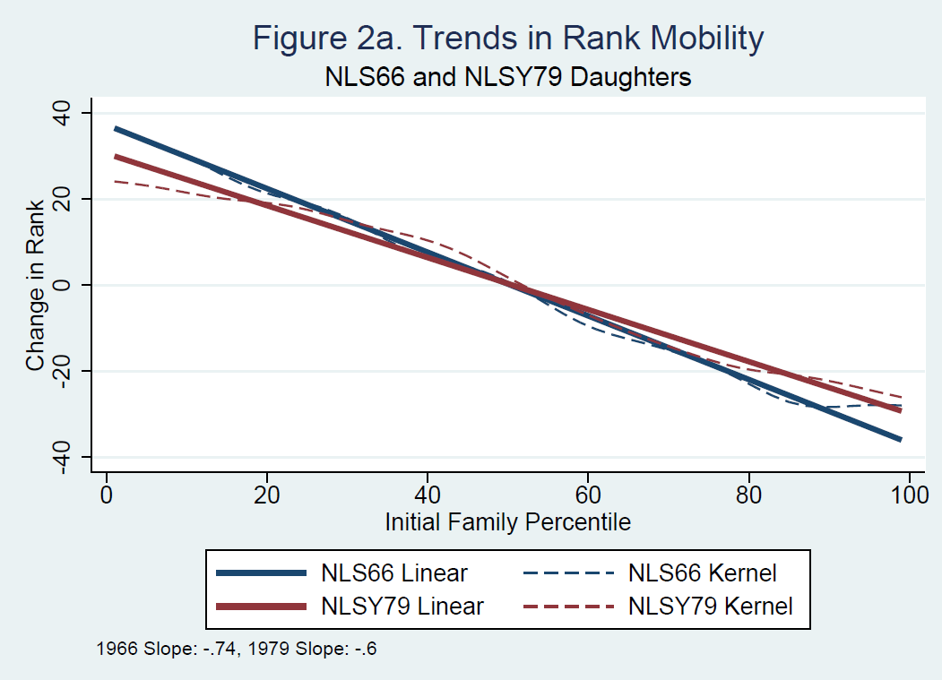
hceconomics.org

Slide 19
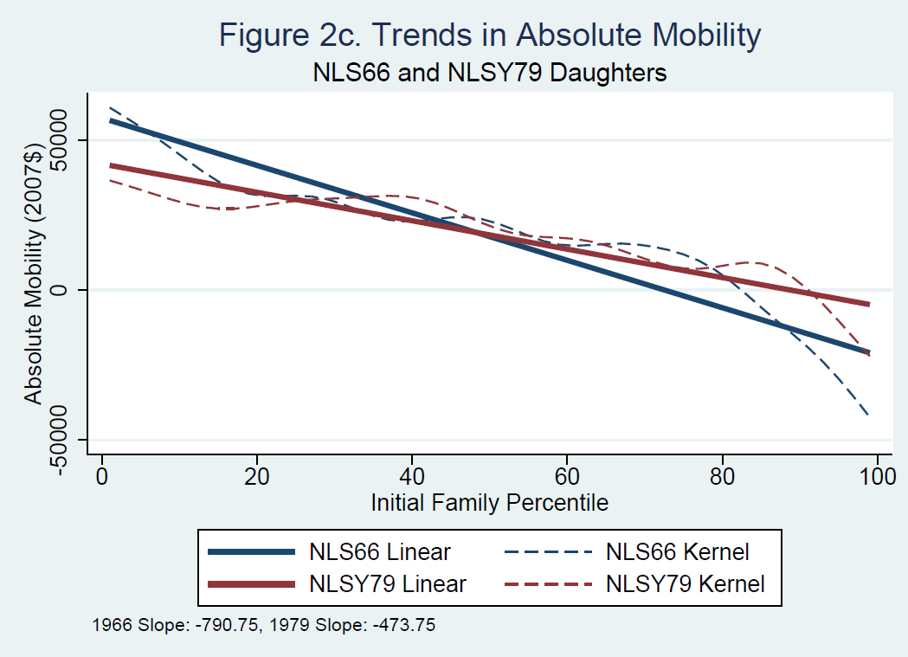
hceconomics.org

Slide 20
Discussion of Trends
Change in slope consistent with previous evidence
Aaronson and Mazumder (JHR, 2008) show historical changes in IGE associated with changes in return to schooling and 90/10 wage gap
hceconomics.org

Slide 21
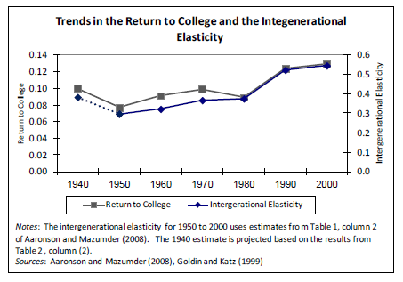
hceconomics.org

Slide 22
Discussion of Trends
Change in slope consistent with previous evidence
Aaronson and Mazumder (JHR, 2008) show historical changes in IGE associated with changes in return to schooling
Bloome and Western (2011) also document a decline in mobility across these cohorts using NLS and NLSY surveys
Levine and Mazumder (2007) show mobility declined across these cohorts by using brother correlations
Bjorklund and Jantti, 2013 argue that this is a preferred measure.
hceconomics.org

Slide 23
hceconomics.org

Slide 24
Discussion of Trends
Change in slope consistent with previous evidence
Aaronson and Mazumder (JHR, 2008) show historical changes in IGE associated with concurrent changes in return to schooling
Bloome and Western (2011) document similar decline in mobility
Levine and Mazumder (2007) show mobility declined across these cohorts by using brother correlations
Bjorklund and Jantti, 2013 argue that this is a preferred measure.
Rank association might not have changed even if IGE did
Other Evidence Misses the Inflection Point:
Chetty et al (2014b) only covers cohorts born since 1970 who entered the labor market in the 1990s well after the rise in inequality.
PSID evidence (e.g. Hertz, 2008, Lee and Solon, 2009), may not be ideal
Oldest cohort living at home in 1968 is 1951
Don’t get a great read of IGE for this cohort until mid 1980s.
hceconomics.org

Slide 25
Good coverage in PSID
Chetty et al (2014b)
hceconomics.org

Slide 26
Cross-country differences
hceconomics.org

Slide 27
International Samples
Germany, SOEP survey data
1071 parent-child pairs. Kids born 1957-79. Avg. HH income measured over 2001-2012 when between ages of 32-54
Parents born 1926-1956, avg. HH income over 1984-1986.
Household income based on cohabitation with partner.
Norway, administrative data, xx% random sample
328 428 parent-child pairs. Kids born 1957-1964. Avg. HH earnings measured over 1996 -2008 when between ages of 32-51.
Parents born between 1920 and 1950, avg. family earnings over 1978-80
Sweden, administrative data, 35% random sample
252,745 parent-child pairs. Kids born 1957-1964. Avg. HH income measured every other year from 1999-2006 and 2007, kids b/w 35-50
Parents born between 1920 and 1950, avg. HH income over 1978-80

Slide 28
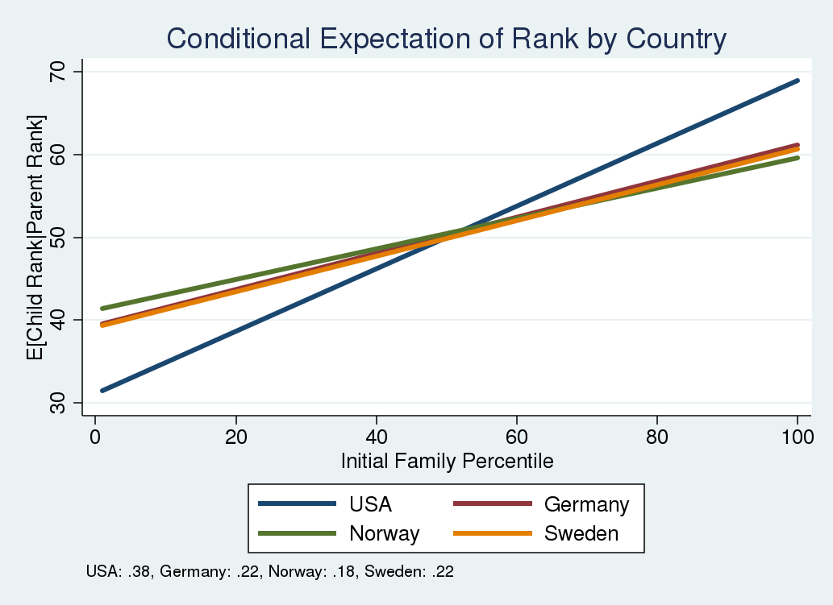
There are only 11 out of 384 US cities with a rank-rank slope <=0.22
hceconomics.org

Slide 29
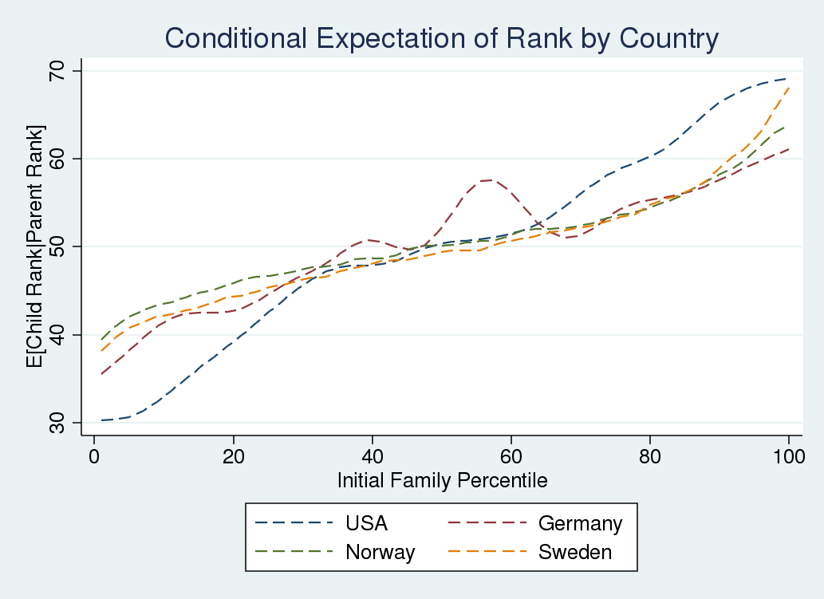
hceconomics.org

Slide 30
Discussion of Cross-Country Differences
U.S. is as much an outlier using rank measures of intergenerational mobility as with IGE
This was not so clear in Corak, Lindquist and Mazumder (forthcoming)
Consistent with evidence for Denmark (slope = 0.18) from Boserup et al (2013) shown in Chetty et al (2014)
Cross-country differences shown here are much larger than differences within the US emphasized by Chetty et al. (2014)
Important non-linearities when looking across countries.
Mobility differences between US and other countries appear to be more extreme at the tails. Mobility similar between 35th and 60th percentiles
Results fairly robust to conceptual differences in income
Mobility better in the US for those in the top-half
Absolute mobility differences yet to come
hceconomics.org

Slide 31
Differences in US by Characteristics
hceconomics.org

Slide 32
NLSY 79 Characteristics
Stratify by Race/Ethnicity and Region
Black, White and Hispanics
South at 14; Northeast, Midwest, South and West at 18
Future work will use geocoded NLSY to get county level attributes at birth
Child and Parent Characteristics:
Kids: AFQT scores, Non-cognitive measures
Family Background Characteristics: Each possible combination of Biological or Non-Biological Parent present.
Parent education: HS, Some College, College, Graduate School
hceconomics.org

Slide 33
Differences by Race/Region

Slide 34
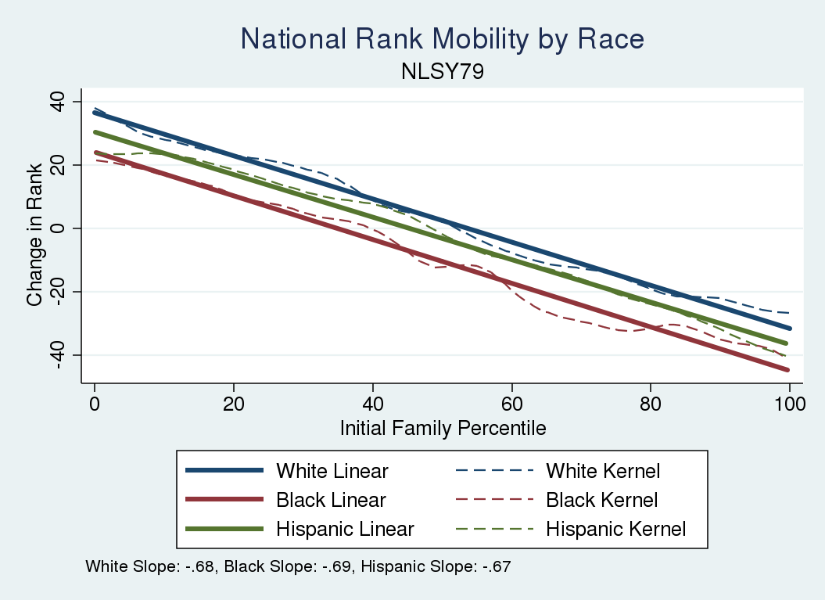
hceconomics.org

Slide 35
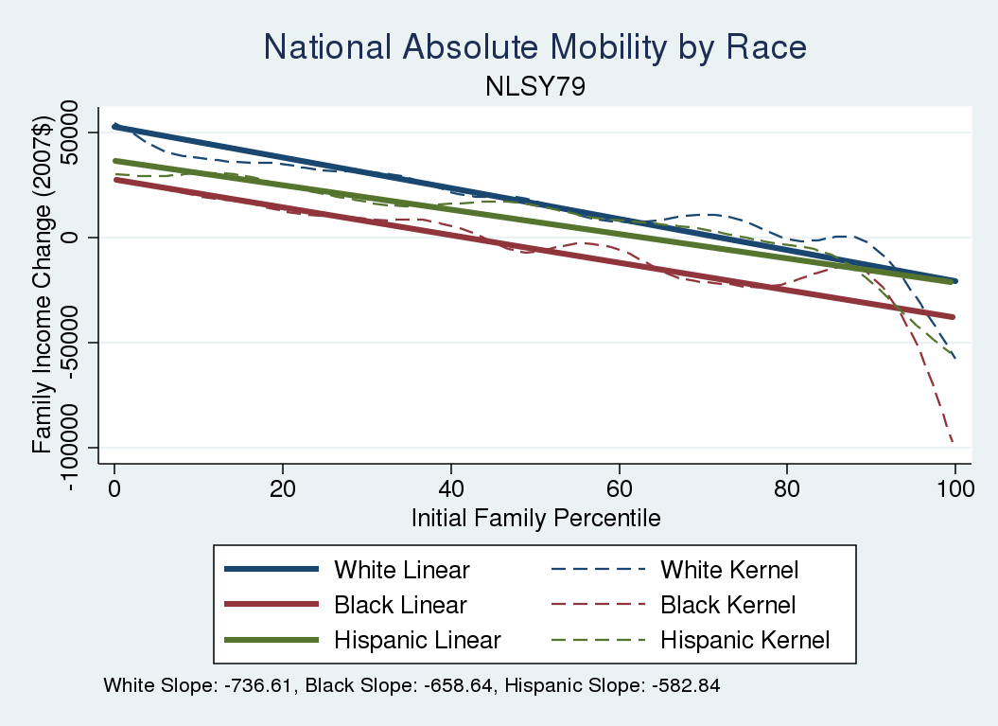
hceconomics.org

Slide 36
Summary of Race/Ethnicity
Stark racial/ethnic differences throughout the distribution in both absolute and relative mobility
Ordering of curves appears to be constant as follows: 1) whites 2) hispanics 3) blacks
Stochastic dominance criteria is easy to apply
Racial differences persist even after including family background controls (not shown)
Previous research has largely ignored Hispanics
Mobility (based on slope) declined for whites and blacks
Mobility unambigously worse for Blacks throughout distribution
hceconomics.org

Slide 37
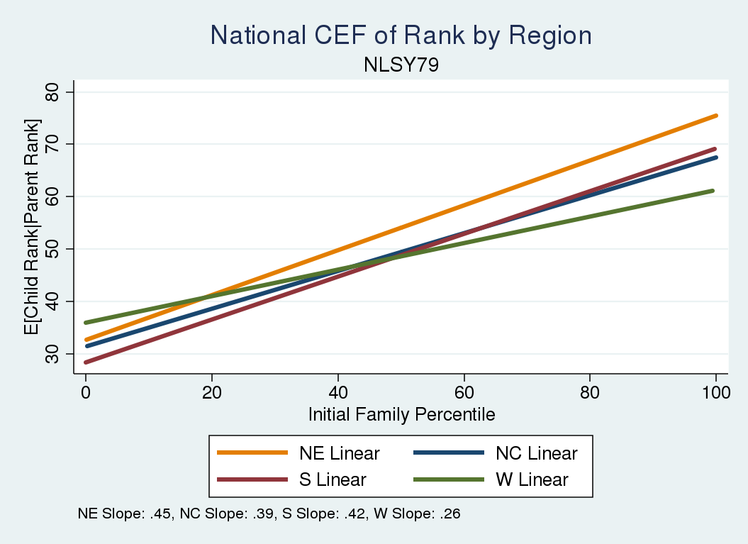
hceconomics.org

Slide 38
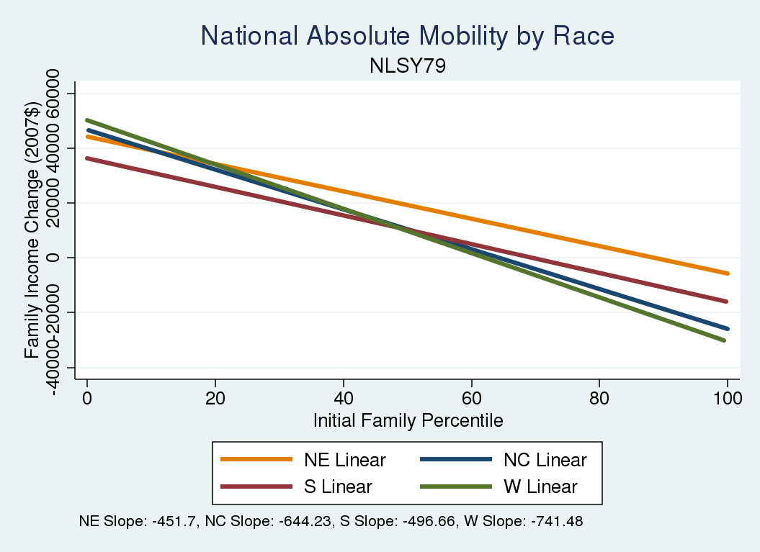
hceconomics.org

Slide 39
Summary of Regional Differences
Regional differences are not so stark at aggregate level
Northeast generally dominates, West has flattest slope
South and North Central are fairly similar
Regional mobility curves cross leading to potentially interesting/nuanced comparisons
e.g. West may be preferred to South for upward rank mobility from bottom but not for downward rank mobility at the top
Conditional on family background, South fares worst
Now we turn to looking at both race and region
Chetty et al (2014a) only look at this indirectly since tax data does not identify race
hceconomics.org

Slide 40
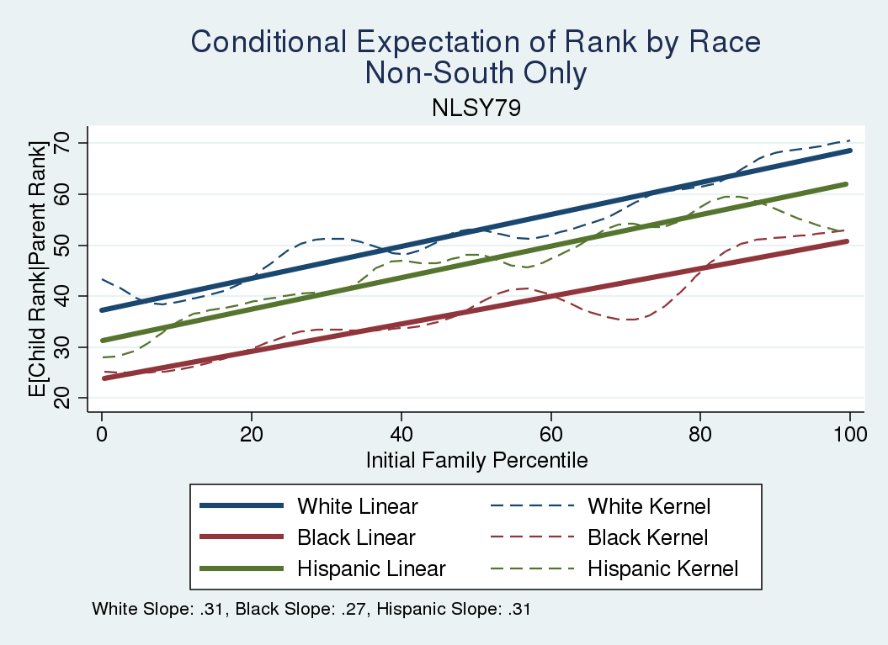
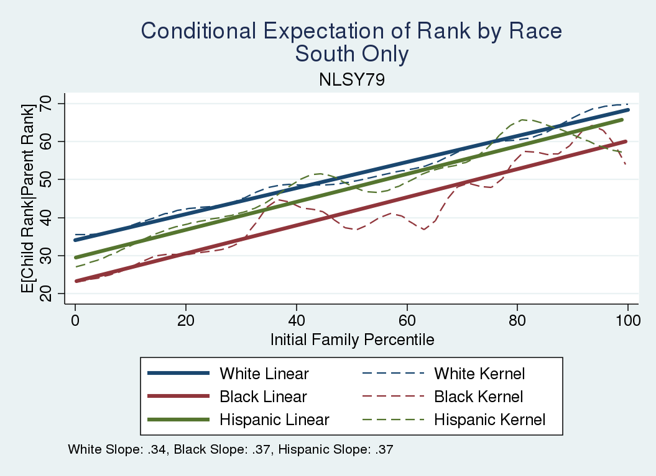
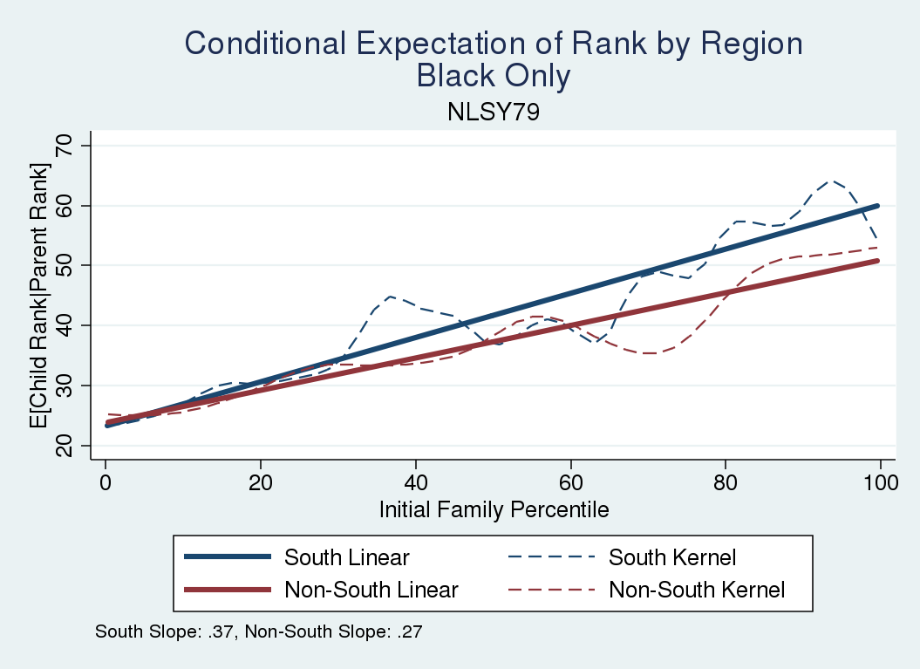
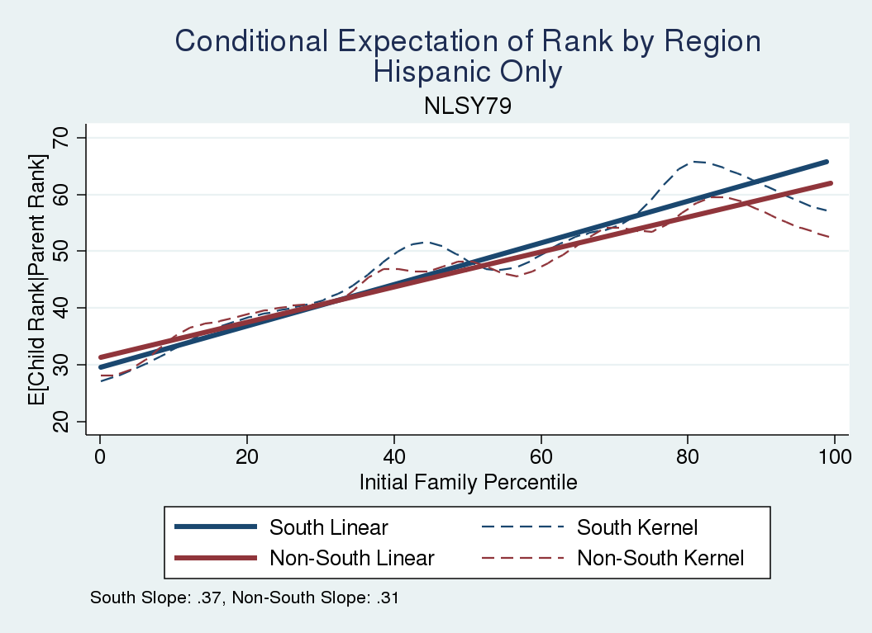
Racial Gaps by South/non-South
Regional Gaps for Blacks and Hispanics

Slide 41
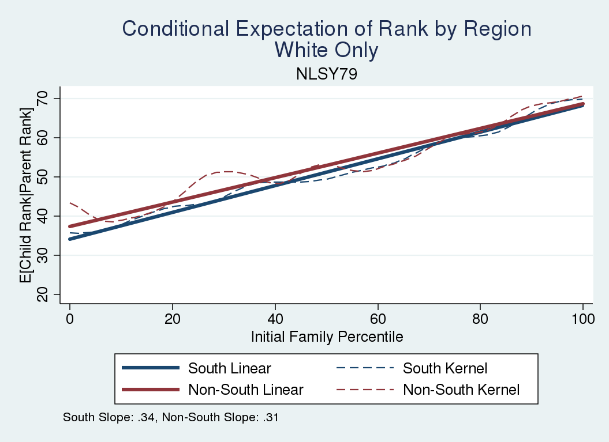
hceconomics.org

Slide 42
Summary of Race by Regional Differences
Overall mobility disadvantage in South conceals considerable heterogeneity by racial group
Blacks and Hispanics are largely doing better in the South, while Whites are largely doing worse.
Provides more complete picture
Geographic differences not so large within group
Regional differences are partially driven by race but not in the “expected” way
While it is true that worse mobility in South is not driven by Blacks (who actually offset it) it is driven by Whites
hceconomics.org

Slide 43
Differences by Cognitive and Non-Cognitive Skills
hceconomics.org

Slide 44
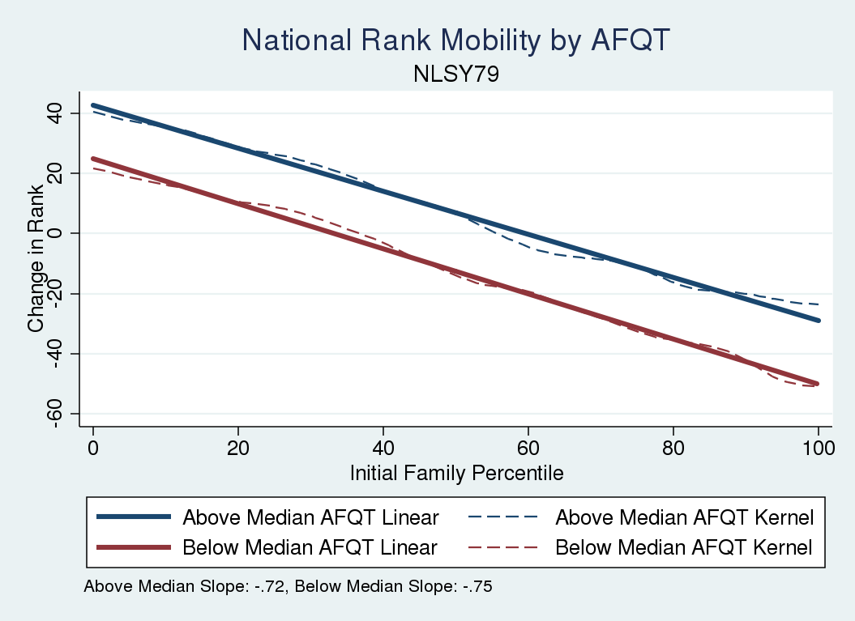
hceconomics.org

Slide 45
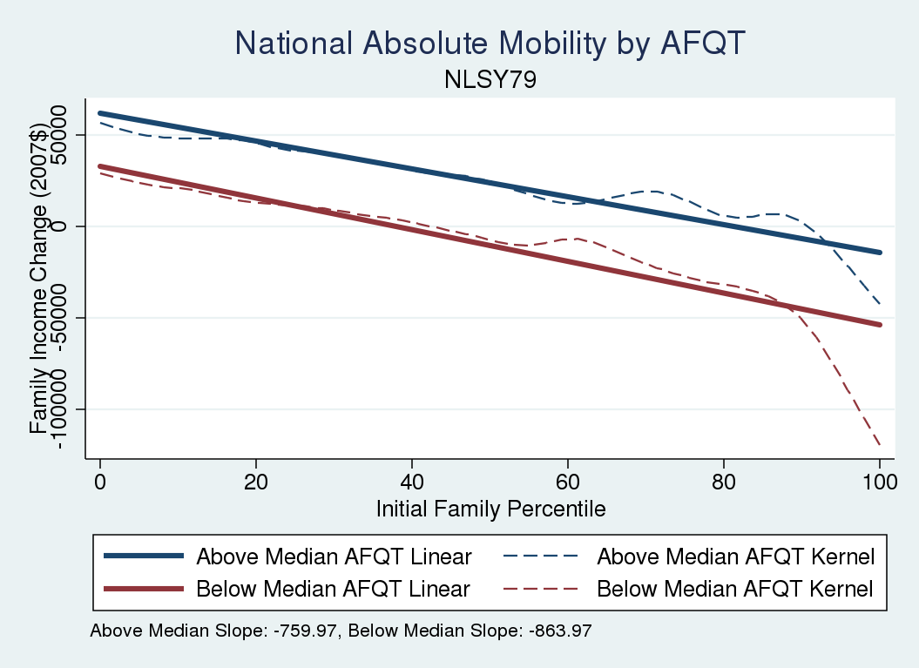
hceconomics.org

Slide 46
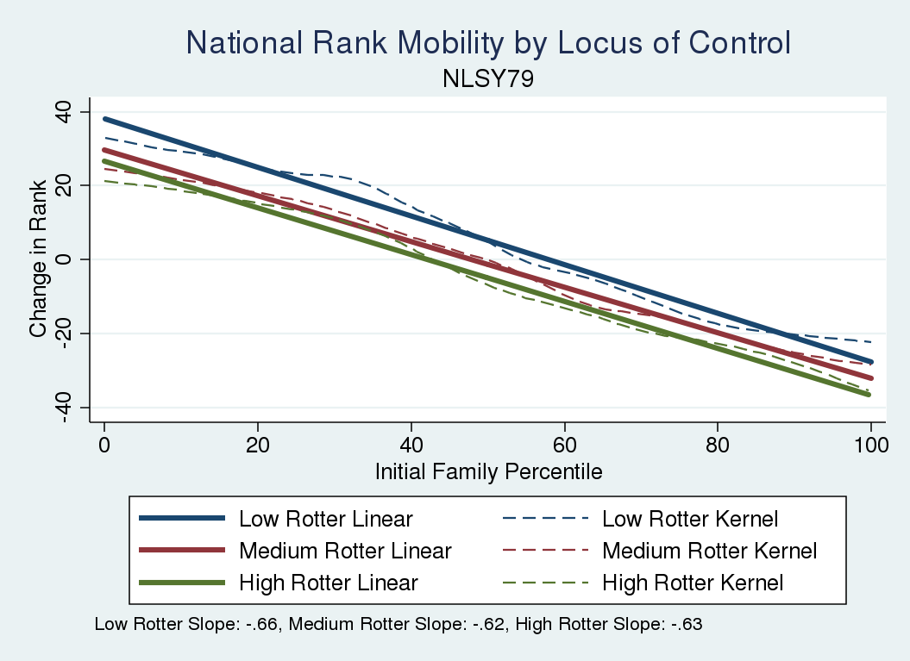
hceconomics.org

Slide 47
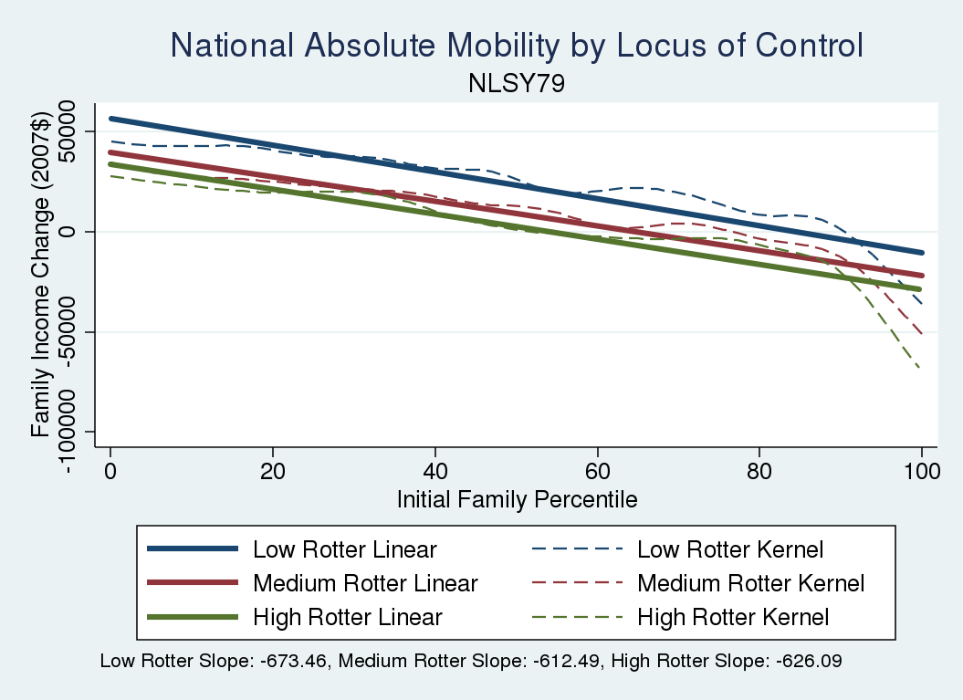
hceconomics.org

Slide 48
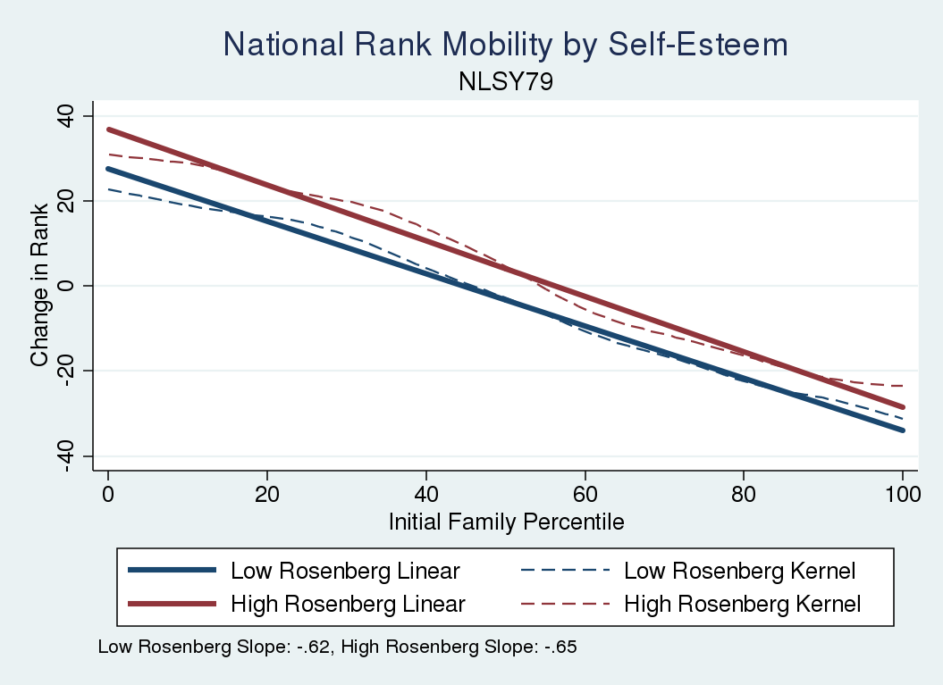
hceconomics.org

Slide 49
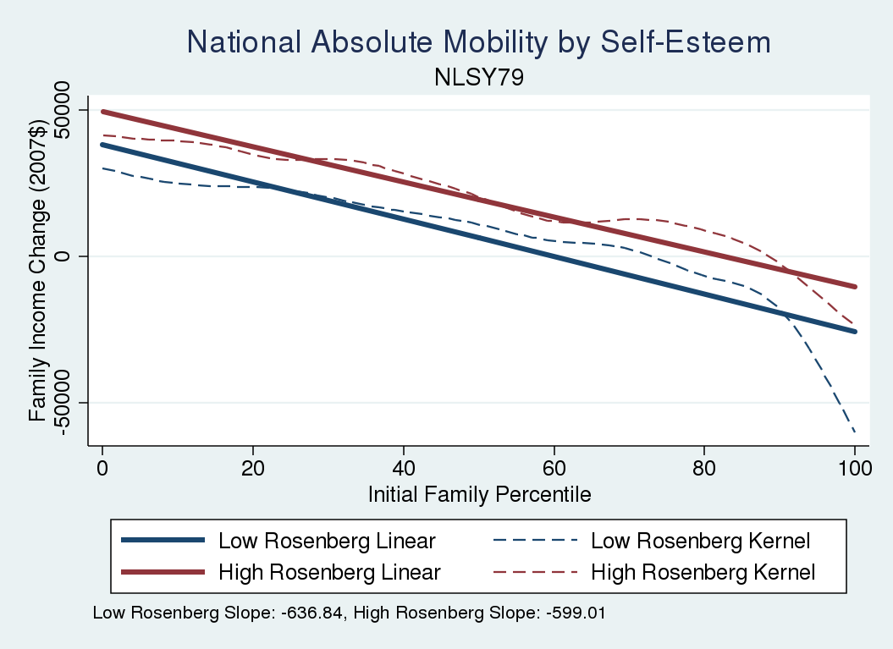
hceconomics.org

Slide 50
Summary of Cognitive/Non-cognitive skills
Large gaps in mobility by cognitive skills for both absolute and relative mobility
Smaller but still notable mobility gaps by non-cognitive skills
hceconomics.org

Slide 51
Conclusion
Introduce new approach to examining intergenerational mobility using mobility curves (building on previous literature)
Present absolute and relative mobility curves for a representative sample of US cohorts now in their 50s
Document a sharp decline in relative rank mobility (slope) compared to earlier cohorts
Consistent with some prior work based on inequality trends
Show US is an outlier relative to Germany, Norway, and Sweden
Document US racial gaps in absolute, relative mobility and first evidence on intergenerational mobility of Hispanics
Provide more nuanced evidence on race and region
Cognitive skills and non-cognitive skills (to a lesser extent) are associated with mobility
hceconomics.org

