Slide 1
Chinese Personality Factors – A Brief Introduction
Hau Chyi
Renmin University of China

Slide 2
Some Background
Prof. Heckman presented “Hard Evidence on Soft Skills” at the “Distinguished Lecture Series in Labor Science” of Renmin University
Stresses the importance of soft skills on outcomes
Of five distinctive personality traits, Conscientiousness is the most predictive across a variety of outcomes.

Slide 3
After that, we went to the summer palace
While strolling along the long corridor, we noticed a common theme:
paintings use tales of symbolized historical figures to promote highly praised personality traits (morality virtues)

Slide 4
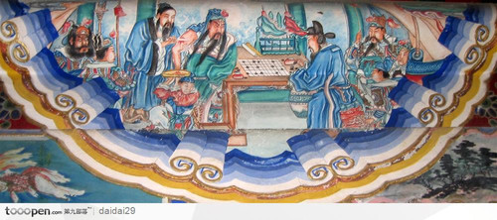
For example,
Guan, Yu：Symbol of Zhong (忠, loyalty), Yi (义, justice) and Yong (勇, courage)

Slide 5
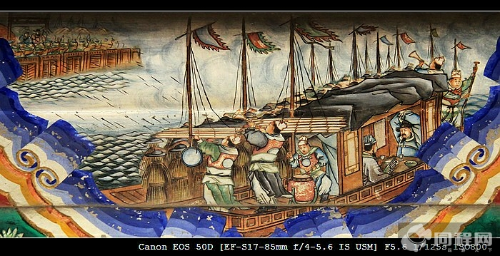
ZhuGe, Liang is famous for his Intelligence/wisdom (智)

Slide 6
Do traditional virtues still matter?
What is the Chinese personality factor structure? Is it different from the Big Five?
Do traditional virtues still describe modern Chinese personality?
How are they related to economic outcomes?
We present some information on Q1 and Q2.
Short answer to Q2 is Yes.

Slide 7
2. Traditional Chinese Morality Traits:
八德, “Eight Virtues” | 四维, “Four Anchors" | 三达德, “Three Great Virtues” | Others
忠 (Zhong, loyalty) | 礼 (Li, sense of propriety) | 智 (Zhi, wisdom) | 节 (Jie, discipline)
孝 (Xiao, filial piety) | 义 (Yi, justice) | 仁 (Ren, humanitarianism / benevolence / magnanimity)
仁 (Ren, humanitarianism / benevolence / magnanimity) | 廉 (Lian, integrity) | 勇 (Courage)
爱 (Ai, love) | 耻 (Chi, honour)
信 (Xin, trusting/trustworthiness)
义 (Yi, justice / generosity / righteousness)
和 (He, getting along/affableness)
平 (Ping, peacefulness/calmness)

Slide 8
Big Five
The Big Five personality factors (OCEAN) are well defined in the English-speaking world:
Openness to Experience
Conscientiousness
Extraversion
Agreeableness
Neuroticism/Emotional Stability

Slide 9
Q1: Chinese Personality Factor Structure
Many studies on this topic:
Cheung, Fanny M., Shu Fai Cheung, Kwok Leung, Colleen Ward and Frederick Leong (2003)
Cheung, Fanny M., Shu Fai Cheung, Jianxin Zhang, Kwok Leung, Frederick Leong and Kuang Hui Yeh (2008)
Cheung, Fanny M., Kwok Leung, Jianxin Zhang, Hai-Fa Sun, Yi-Qun Gan, Wei-Zhen Song, Dong Xie (2001)
Wang, Deng-Feng and Hong Cui (2007, in Chinese)
Wang, Deng-Feng, Hong Cui and Fan Zhou (2005)
Wang, Deng-Feng Fang Lin and Zuo Yantao (1995, in Chinese).
Zhou, Xinyue, Gerard Saucier, Dingguo Gao, and Jing Liu (2009)

Slide 10
Q1: Chinese Personality Factor Structure
Six Factor:
Cheung et al. (2001)
Seven Factor:
Zhou et al. (2009)
Wang et al. (2005) and Wang and Cui (2007)

Slide 11
Q1: Why are they different?
The base of their lexical studies are different:
Zhou et al. (2009) use Contemporary Chinese Dictionary to pick 413 terms.
Cheung et al. (2001) use Chinese Personality Assessment Inventory (CPAI) and only has 150.
Openness is missing in CPAI. As a result, Cheung et al. (2008) developed CPAI2.
Self-rating vs. peer-rating
Self-rating can be more awkward than peer ratings in non-Western cultures.
However, the former is more convenient;
The two methods yield different factor structures (Zhou et al. 2009).

Slide 12
Q1: The Seven Factor Model by Zhou et al. (2009)
Intellect/Positive Valence (similar to O)
Conscientiousness/Diligence (C)
Extraversion (E)
Emotional Volatility (N)
Gentle/Even Temper
Noxious Violativeness/Harmfulness
Dependence/Fragility
See Table 1 of Zhou et al. (2009) for correlated traits

Slide 13
Q1: Chinese Big Seven vs. (Western) Big Five
Agreeableness is split into two traits:
Gentle/even temper:
Even temper as opposed to hostility
Noxious violativeness/harmfuless:
Honesty and humility as opposed to egotism and deceit
This is also found in French, Hungarian, Italian and Korean studies (see Zhou et al. 2009).

Slide 14
Q1: Chinese Big Seven vs. (Western) Big Five
Chinese Big Seven have a (negative) interpersonal relatedness trait that is not in the Big Five.
This trait includes Ren Qing (relationship orientation), Harmony, and Face.
Using translated CPAI on a sample of Caucasian students, Cheung et al. (2003) find that interpersonal relatedness is also relevant to them.

Slide 15
Q2: Do traditional virtues still matter in describing modern Chinese personality?
Two related questions:
Do the traditional Chinese virtues even describe personality of “ancient” Chinese people?
Do traditional virtues still matter?

Slide 16
Q2-1: Do the traditional Chinese virtues even describe personality of historic Chinese?
Yang (2005) uses ShiJi (Records of the Grand Historian, written in 91BC) to extract 98 characters from 1241 personality describers
He finds a Four Factor Model, including:
Ren (仁, love/caring)
Zhi (智, intelligence)
Yong (勇, courage)
Ying (隐, being a hermit)

Slide 17
Q2-1: Do the traditional Chinese virtues even describe personality of historic Chinese?
In them, virtues mentioned previously describe more than 80% of the terms
Predictably, they are all in Ren, Zhi and Yong.
Ying is the one that is not included in Eight Virtues, Four Anchors, nor Three Great Virtues.
However, most of its facets are the exact opposite of those used in extraversion.

Slide 18
Q2-2: Do traditional virtues still matter?
Although not one-to-one, the traditional traits can still be mapped.
We will work more on a more systematic method of mapping between these virtues and modern personality traits.

Slide 19
What about Q3?
How are these virtues related to (economic) outcomes?
Data linking personality traits and outcomes are essential.
We would also like to control, say, family background and macroeconomic factors.

Slide 20
Tentative Idea for Q3:
Biographies (列傳) list 234 prominent “ancient” Chinese
They are philosophers, politicians, business men, even assassins
Sima, Qian, the author, picked according to two criteria:
Representativeness of different facets of Chinese
Social functions
(such as biographies of Flatterers 佞幸列傳, Jesters 滑稽列傳, diviners, 龜策列傳)
They form our “observations”

