Slide 1
Credit Subsidies for Higher Education
Deborah Lucas
MIT Sloan
Prepared for the 9th Csef-Igier Symposium on Economics and Institutions
Anacapri, June 2013

Slide 2
Introduction and Overview
Credit subsidies are one of the main ways that governments subsidize higher education
Credit subsidies can be efficient when information problems impede private lending
However, credit subsidies tend to be significantly undervalued in government budgets
That creates a legislative incentive to excessively rely on credit versus other forms of assistance
  e.g., Pell grants vs. loans in the U.S.
  Analysis of student loans is part of a broader research agenda on these issues

Slide 3
Introduction and Overview
Over-reliance on credit is especially problematic if students don’t fully understand the risk of over-indebtedness
  Potentially micro- and macro-economic consequences
Optimal debt management by borrowers is also impeded by extremely complex program rules
  Governments have limited incentives to improve credit product design because competition is priced out

Slide 4
Introduction and Overview
An analysis of the student loan consolidation option provides insights on several of these issues
  High and largely unrecognized cost to government
  Random benefits across different cohorts of student
  Laboratory for studying how unsophisticated borrowers respond to financial incentives (and how markets can help)
Concluding comments

Slide 5
U.S. Federal Student Loans Outstanding
1998 to 2010

Slide 6
Government undervaluation of credit subsidies
For budgeting and financial reporting purposes, governments treat their cost of capital as their borrowing cost
  For example: The gov’t makes a student loan for $1,000 for one year and charges 3%. The Treasury rate of 2%. The default rate is 10%. The recovery rate is 50%.
  Subsidy is $40.69
That assumption violates the basic logic of financial economics, and neglects the costs borne by taxpayers…

Slide 7
Why the government’s cost of capital exceeds Treasury rates
The government makes a student loan for $1,000, due in one year, notionally funded with Treasury debt.
Loan interest rate = 3%, Treasury rate = 2%
    Assets Liabilities
    Risky loan $100m Treasury Debt $100m

Slide 8
Why the government’s cost of capital exceeds Treasury rates
Notional balance sheet at end of the year if the loan pays off in full:
    Assets Liabilities
    Cash $1030 Treasury Debt $1020
    Taxpayers $10

Slide 9
Why the government’s cost of capital exceeds Treasury rates
Notional balance sheet at end of the year if the loan defaults and recovery is $515 (50% recovery rate):
    Assets Liabilities
    Cash $515 Treasury Debt $1020
    Taxpayers -$505
Treasury borrowing costs are low because of taxpayer backstop.
Taxpayers are equity partners in government credit obligations.
The government’s cost of capital is a weighted average of the cost of debt and equity (as for a private sector firm).
“Fair value” estimates calculated using risk-adjusted discount rates provide a more accurate picture of costs.

Slide 10
Cost understatement for student loans
Estimates from “Guaranteed versus Direct Lending: The Case of Student Loans,” by D. Lucas and D. Moore, in Measuring and Managing the Risk of Federal Financial Institutions, 2010
In projected cash flows accounted for optionality arising from grace, deferment, forbearance, default, consolidation, prepayment; also for transaction costs
Cost of capital inferred from private student loan rates
Cost of capital is significantly higher than Treasury rate because defaults rise and recoveries fall during recessions—the risk is systematic

Slide 11
Imputed cost of capital for loans
 | Private Loans
Average Loan Interest Rate | LIBOR + 4% p.a.
Losses from default | 1% p.a.
Origination, Servicing | 70 bps p.a.
Libor Spread over Treasury | 30 bps p.a.
Cost of Capital | Treasury + 2.6% p.a.
Private loan market data used to identify market cost of capital

Slide 12
Fair value subsidy rates vs. budgetary subsidy rates
 | Direct | Guaranteed
Base Case (Jul 06 – Jun 07) | 20.1 | 31.3
High risk premium (3.6%) | 26.2 | 36.2
Low risk premium (1.6%) | 12.6 | 25.3
No risk premium | 1.1 | 16.5
25% faster repayment | 17.3 | 27.1
25% slower repayment | 19.8 | 31.0
Subsidy rate is $subsidy per $ loan principal (%)

Slide 13
Current fair value subsidy rates vs. budgetary subsidy rates
For several years subsidy rates have been negative
  Artifact of discounting at Treasury rates and high statutory interest rates
In 2013, new student loans were $113 billion.
Subsidies according to CBO:
  Budgetary subsidy rate of -32% (deficit reduced by 32 cents per dollar of loan extended)
  Fair value subsidy rate of -4.9% (negative fair value subsidy because administrative costs accounted for separately)
Recent changes liberalizing income-based repayment will increase future costs

Slide 14
Analysis of the student loan consolidation option
“The Student Loan Consolidation Option,” (2013), D. Lucas and D. Moore
The consolidation option is:
  An exotic financial derivative, created by a few paragraphs in the Higher Education Act
  An example that shows how to use modern options pricing methods to better inform public policy
  A loan feature that has significantly increased the size and volatility of student loan subsidies
  A laboratory to study the response of relatively unsophisticated borrowers to financial incentives

Slide 15
Analysis of the student loan consolidation option
We find that:
  The ex-ante cost of the option ranged from 0.8 percent to 6.4 percent of loan principal between 1998 and 2005. Ex post the cost totalled $27 billion over the period.
  Borrowers (with the help of self-interested lenders) responded to the time-varying incentives to consolidate although some left sizeable amounts of money on the table
  More indebted borrowers were more likely to optimize
  There is some evidence of learning over time

Slide 16
The federal student loan program
Two competing federal programs: direct and guaranteed
  Both very similar from a student perspective
  Cost to government higher in guaranteed program because of “special allowance payments” to lenders
Analysis covers 1998 to 2005
During that period loans had floating rates
  fixed spread over 3-month Treasury rates, annual reset
  “subsidized” and “unsubsidized”
Maturities ranged from 10 to 30 years
Rate capped at 8.25%

Slide 17
The consolidation option
Two components:
  Interest rate option or “swaption”
    Can swap floating rate into fixed rate debt, at average rate on outstanding floating loans
  Extension option
    Allows maturity extension of some loans, up to 30 years for high-balance borrowers

Slide 18
Consolidation option: benefits to students
Interest rate option
  Often deeply in the money b/c of upward sloping yield curve
Extension option
  Increases the PV of rate subsidy
  Relaxes liquidity constraints by lowering monthly payments

Slide 19
Modeling cost of consolidation option
Value to student may not equal cost to government
Borrowers face liquidity and other constraints
  Complicates the evaluation of whether they are behaving rationally, and of what the option is worth to them
  We therefore do not attempt to quantify the value to students
We assume the cost to the government is only affected by standard financial considerations
Cost of option to government depends on
  Borrower behavior (including prepayments and defaults)
  Program rules
  Interest rate conditions

Slide 20
Model of borrower behavior
Behavioral model based on 700,000 records from the National Student Loan Data System (NSLDS) from the Dept. of Education
  Loan characteristics (program, original maturity and amount)
  Limited borrower characteristics (school name, undergrad/grad/prof)
  Status of loan over time (school, grace, defaulted, consolidated, extended)
Constructed a time series for each borrower with consolidation events, loan amount outstanding, consolidation interest rate, etc.

Slide 21
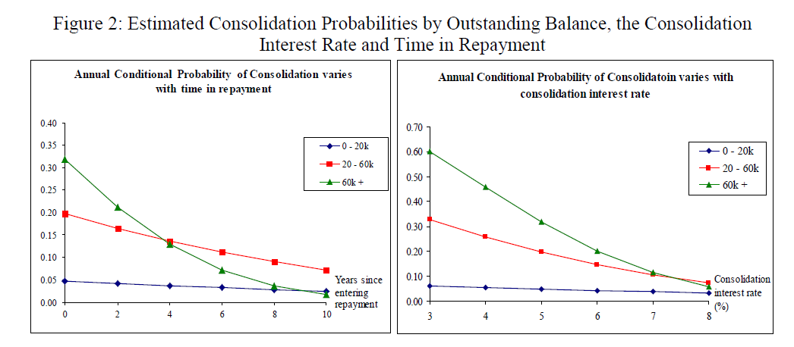
Model of borrower behavior
Probit regression to estimate probability of consolidation in any year
  Based on loan program, balance category, current short-term rate, interactions, years in repayment, year dummies

Slide 22
Model of borrower behavior
Probit model used in prospective cost estimates to predict consolidation behavior
Data suggests that students do not fully optimize
  Some students consolidate even when the option is out of the money
  Others fail to consolidate even when the option is deep in the money
  Analogously to mortgage valuation, cost estimates depend on actual not theoretical behavior

Slide 23
More on borrower behavior
Guaranteed lenders had a strong financial incentive to attract consolidation loans
Original guaranteed lenders lost money when a student consolidated, but could not prevent consolidation
Heavy advertising by consolidators probably accounts for why such a large proportion of students behaved close to optimally
It also may have contributed to the increasing propensity for students to consolidate over time
Under direct lending program that replaced guaranteed lending, such a situation could not arise in the future

Slide 24
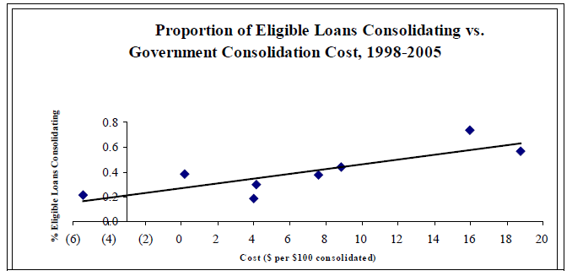

Slide 25
Model of interest rates
Standard 2-factor Cox, Ingersoll, Ross model (CIR)
  Stochastic, mean-reverting short-rate
  Closed form solution for long rates
  Addition of default risk premium
  Calibrated to match the relevant market conditions (historical or forward-looking)
Affects cash flows and discount rates
Option cost increases with
  The slope of the yield curve
  The volatility of interest rates

Slide 26
Cost to the government: a valuation model
Monte Carlo simulation, where along each time path…
  Short and long-term interest rates evolve stochastically, according to CIR model
  For a loan eligible for consolidation, can compute at each date:
    Permanent fixed rate, payment amount, if consolidate
    Current floating rate, payment amount, if do not consolidate
  Check whether consolidation occurs at that date
    If not, record cash flows on old loan and go to next date
    If so, record cash flows on consolidation loan and go to next date
    Note, cash flows adjusted for expected rate of defaults and prepayments
Option value is difference in PV of loan cash flows, with and without consolidation option, avg’ed across all paths

Slide 27
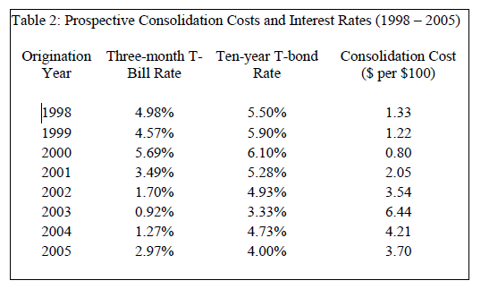
Results: prospective government costs

Slide 28
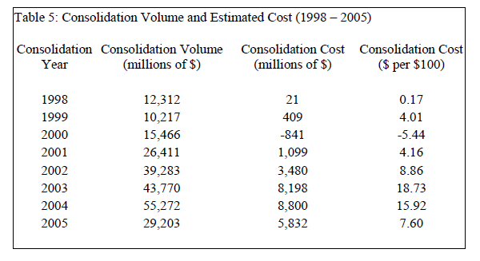
Results: realized government costs
Note: These results do not rely on the behavioral model, as the realized volume of consolidation is assumed to occur.

Slide 29
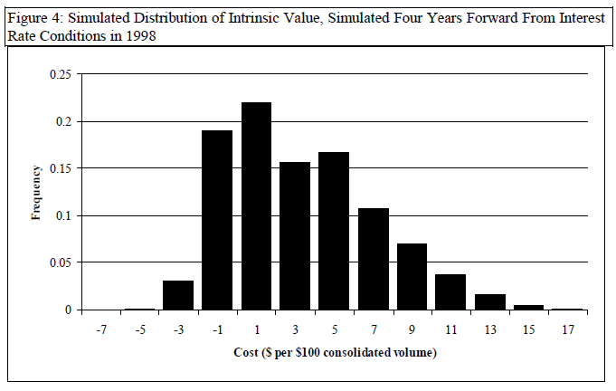
Results: realized costs were not too surprising

Slide 30
Concluding comments
Broad goal is to show how the tools of modern financial economics can be used to better inform policymakers and the public about credit subsidies and product design.
The budgetary cost of government credit subsidies is biased downward because capital costs are understated.
  Favors credit assistance over alternatives such as grants
The consolidation option is an example of an expensive, opaque, and poorly targeted subsidy for higher education
  Helped students most who had already obtained an education
  Helped students most at high-cost schools

