Slide 1
Inequality and the Middle-income Trap
Yang Yao
NSD & CCER

Slide 2
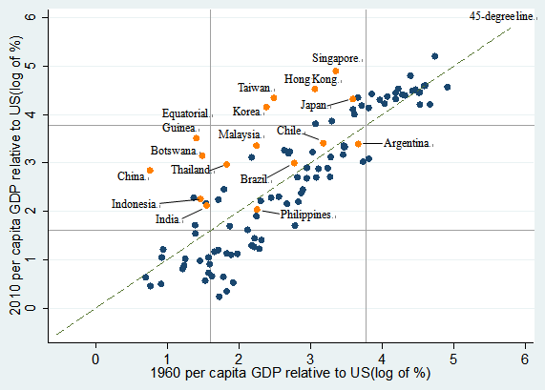
The trap is real
Total: 110 “middle” or “low” in 1960: 88 Decline: 51
Rise by 10 percentage point: 19 From “middle” to “high”: 11

Slide 3
Which way will China take?
Source：Penn World Table 7.0.

Slide 4
Inequality
Panel A: Gini coefficient of income
Country | 1950s | 1960s | 1970s | 1980s | 1990s | 2000s
Argentina |  |  |  |  | 51.8
Brazil |  | 53.0 | 57.6 | 57.8 | 59.6 | 61.2
Korea | 34.0 | 32.0 | 33.0 | 38.6 | 34.7 | 36.9
Malaysia |  |  | 50.0 | 48.0 | 49.9 | 49.9
Philippines | 46.1 | 49.7 | 49.4 | 46.1 | 47.9 | 49.4
Taiwan |  | 32.2 | 29.4 | 28.0 | 30.1 | 34.5
Panel B: Gini coefficient of land
Country | 1960s | 1970s | 1980s | 1990s | 1960s
Argentina | 85.6 |  |  | 81.4 | 85.6
Brazil | 84.0 | 84.0 | 85.0 | 85.0 | 84.0
Korea | 34.0 | 37.0 | 35.0 | 34.0 | 34.0
Malaysia | 64.0 |  |  |  | 64.0
Philippines | 56.0 | 51.0 | 51.0 | 55.0 | 56.0
Taiwan | 39.0 |  |  |  | 39.0

Slide 5
Education matters
Notes:
从平均受教育年限来看，走出国家和未走出国家的时间趋势非常相似，但就中学教育来看，二者的路径在1980年左右出现了分岔，高等教育也是如此（入学率亦然）。

Slide 6
Inequality, education and growth
Early stage
Inequality leads to concentration of education which raises the total return to education;
Inequality is good for a country to escape the poverty trap.
Medium stage
The marginal return to education declines as a few people get more education and higher aggregate returns are possible when more people get education;
Inequality leads to the middle-income trap.
Return
Education

Slide 7
Inequality of education in China
Notes: The dark color bars are for urban areas, and the light color bars are for rural areas. Data are for 9,357 adults in 25 provinces in 2010.
Source: CFPS 2010.

Slide 8
A case: wages and education of construction workers in Chongqing at the end of 2012
(source : Chongqing University research group http://money.163.com/12/1204/08/8HSA59SR00252V0H.html)
Wages
Average salary: 3191 yuan/moth
Distribution: 2000～3000 yuan（25.62%）; 3000～5000 yuan（45%）; 5000～8000（20.66%）
Large gaps between jobs: more technically demanding jobs pay better
Long working hours: longer than 10 hours per day
Low education: <= elementary school (39.94%), middle school (51.52%), >= high school (8.5%)

Slide 9
Doubling income by 2020?
Will migrant workers earn a salary of 1,000 dollars in today’s price by 2020?
It will be very difficult
Being defeated by the current success?
The willingness to invest in children’s education is declining in the countryside because of the fast growing wage rates

Slide 10
Investing in people is more productive than investing in roads
Formal schooling
The National Plan for Medium and Long-term Educational Development and Reform for 2020
The Chinese government needs to improve the education and skills of the migrant workers
Investing 30 to 50 billion yuan a year into vocational training is worthwhile

