Slide 1
Changes in preferences and everyday thinking in the context of poverty
Anuj Shah

Slide 2
Disparities
Missed appointments
Poor medical adherence
Fewer words spoken/less reading to kids
Harsher, less consistent discipline
Less productive at work
Marital instability
Borrow too much, save too little
More vulnerable to fraud
Get less sleep
Lower self-esteem
Greater stress

Slide 3
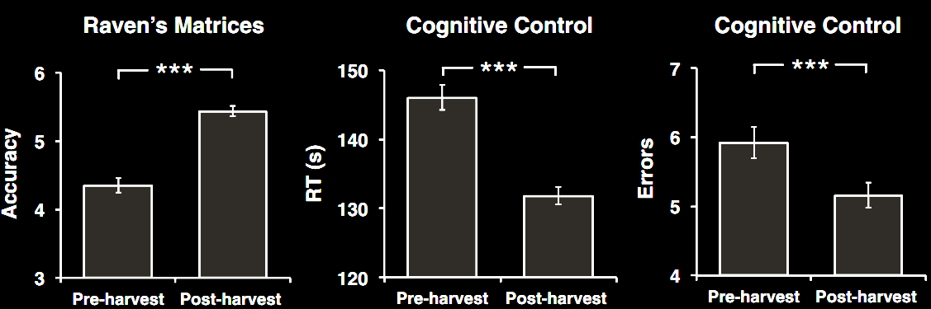
Poverty impedes cognitive function

Slide 4
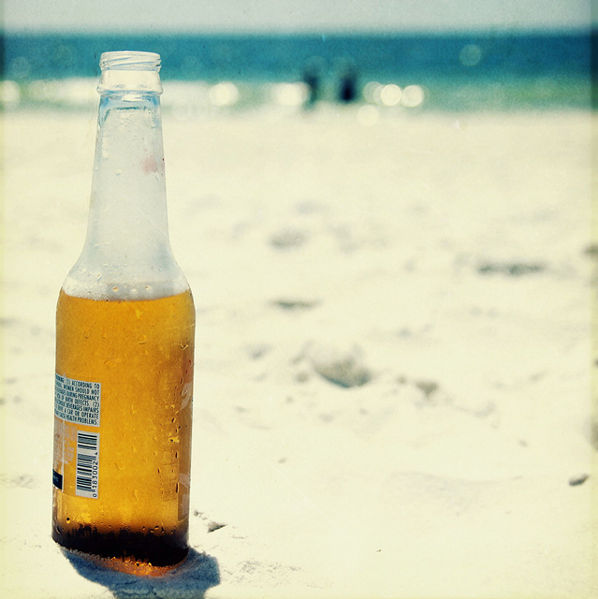

Slide 5
A beer on the beach
Thaler (1985)

Slide 6
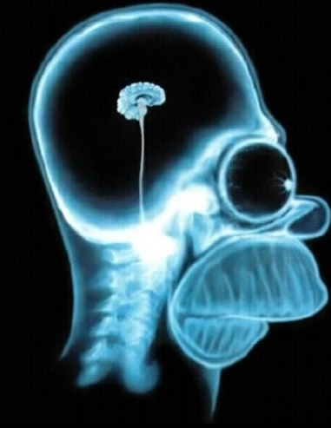
Poor decisions
+
Our decisions are often swayed by normatively irrelevant factors.

Slide 7
Study 1: A beer on the beach
N = 578

Slide 8
Replication
N = 1898

Slide 9
Replication
N = 145

Slide 11


Slide 13
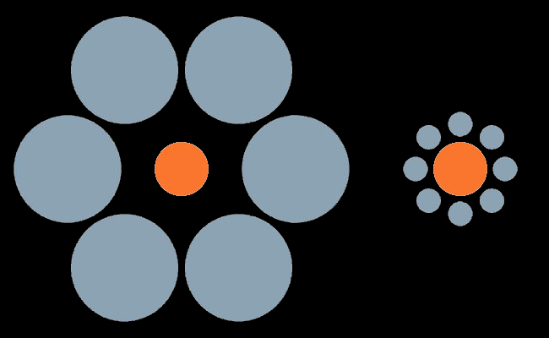

This is insight guides the use of “framing effects” in policy.

Slide 14
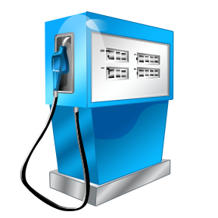
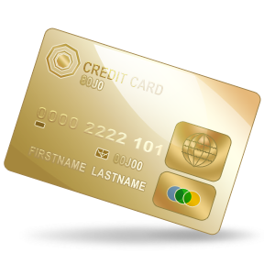

Having more means…

Slide 15

Having more means…

Slide 16
Having less means…

Slide 17

Scarcity and context
Abundance:
Scarcity:

Slide 18
Study 1: A beer on the beach
N = 578

Slide 19
Study 2: Reasons
N = 102

Slide 20
Study 3a: Proportional thinking
$50 | $50 | $50
$300 | $500 | $1000
Tversky & Kahneman(1981)

Slide 21
Study 3a: Proportional thinking
N = 238

Slide 22
Study 3b: Proportional thinking
N = 702

Slide 23
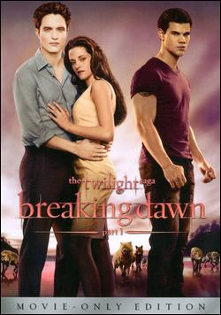
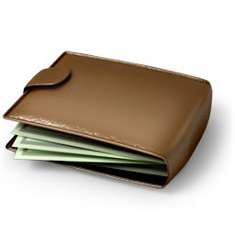

Study 4: Mental accounts
“that’s expensive!”
“that’s not so bad.”
Morewedge et al. (2007)

Slide 24
Study 4: Mental accounts
N = 259

Slide 25
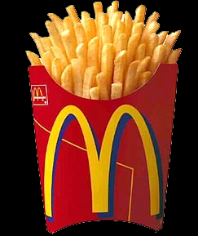
Study 5: Caloric scarcity

Slide 26
Study 5: Caloric scarcity
N = 259

Slide 27

Study 6: The feud

Slide 28
Study 6: Expensiveness
N = 73

Slide 29
Implications
Certain policy levers may not be as useful in nudging the poor
Reconciling economic and psychological views of decision making
A possible reason for diminished bandwidth
Some capacities are honed, rather than diminished

Slide 30

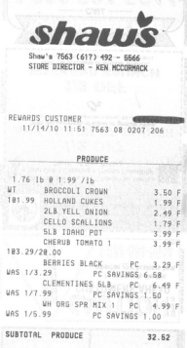
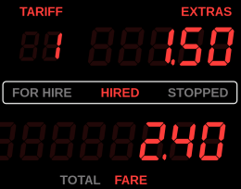
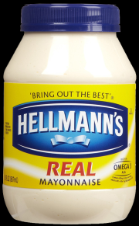
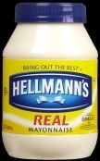
Honed capacities
Tradeoff thinking
Preference stability
Price knowledge
Alertness
Careful spending

Slide 31

Honed capacities
Tradeoff thinking
Preference stability
Price knowledge
Alertness
Careful spending

Slide 32
Please don’t fall asleep.
rest
awake
nap
male
uncle
son
bed
dream
lady
woman
tired
SLEEP
strong
MAN
wake
beard
snooze
doze
handsome
doze
blanket
slumber
snore
muscle
father
person

Slide 33
The fabric of thoughts
rest
awake
nap
male
uncle
son
bed
dream
lady
woman
tired
SLEEP
strong
MAN
wake
beard
snooze
doze
handsome
doze
blanket
slumber
snore
muscle
father
person

Slide 34
Study 7: Seeing what isn’t there
male
uncle
son
rent
loan
phone
lady
woman
pay
dollar
strong
MAN
MONEY
beard
cash
coin
handsome
doze
utilities
gas
muscle
father
person
grocery
bills
expense
N = 125

Slide 35
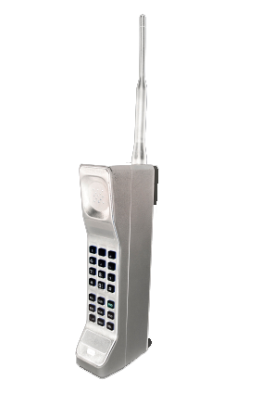
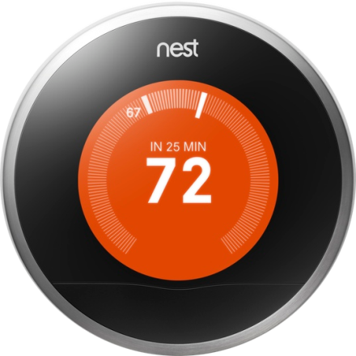
$

Slide 36
Three questions
Do the poor spontaneously think about money?
Are these thoughts hard to suppress?
Do these thoughts interfere with how we enjoy experiences?

Slide 37
Study 8: A visit to the doctor
Imagine that you have been feeling sick lately and finally decide to go see a doctor about it…The doctor explains that you have a serious condition that requires immediate attention. The good news, however, is…you are virtually guaranteed to make a full recovery...The doctor writes several prescriptions…You will also need to make several appointments…
What would be on your mind or how would you feel as you hear this news… What are three things you would think about or feel?
“wife son coworker”
“scared afraid worried”
“relief hope joy”
“cost family work”

Slide 38
Study 8: A visit to the doctor
Proportion mentioning money-related thoughts
N = 198

Slide 39
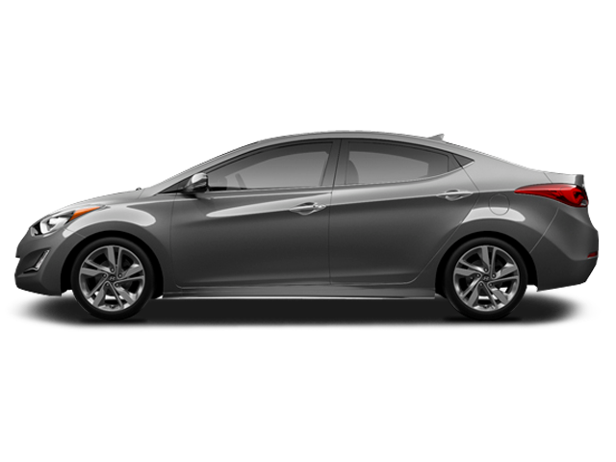
Study 9: Distracted driving
Try not to think about how much you drive each month.
Try not to think about how much you spend on driving each month.

Slide 40
Study 9: Distracted driving
N = 568

Slide 41
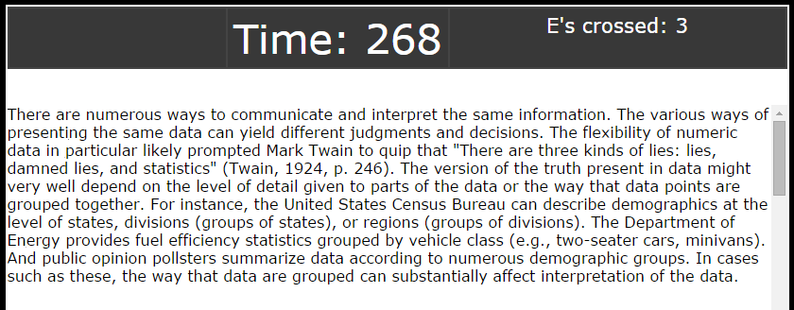
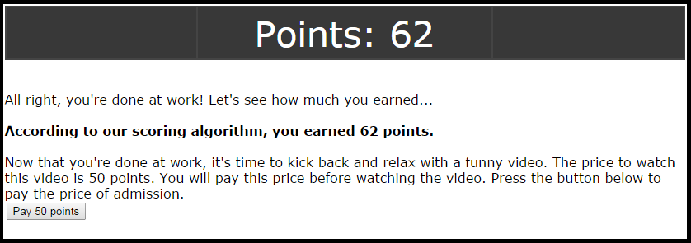
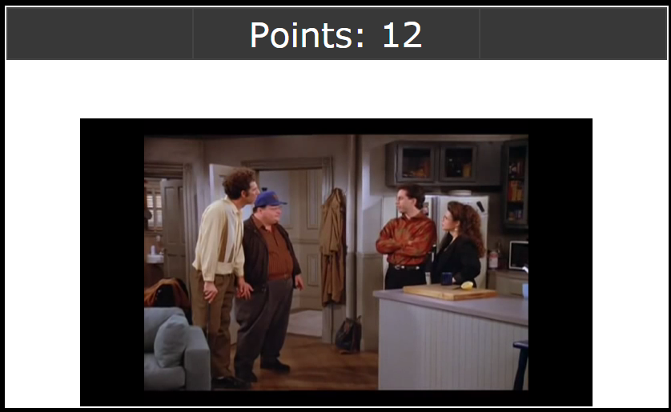
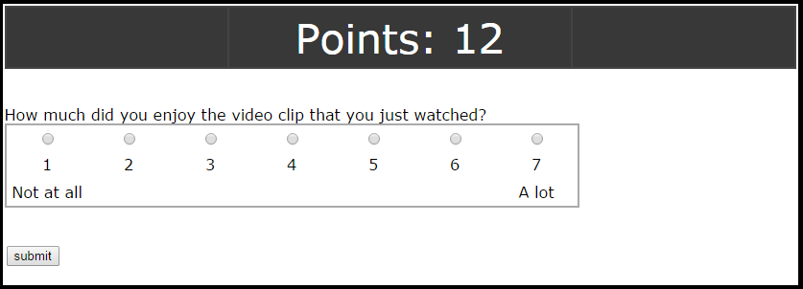
Study 10: Hedonic interference

Slide 42
Study 10: Hedonic interference
N = 297

Slide 43
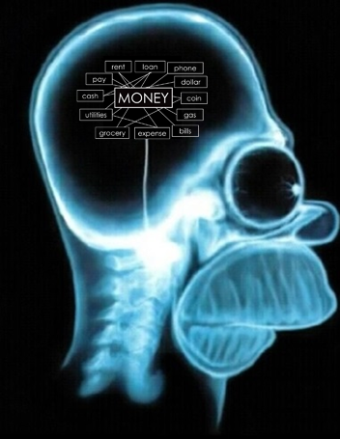
A cognitive psychologist’s view of poverty
Less susceptibility to framing effects
Money-related thoughts are highly accessible or top of mind

